Slide 1
HAND GESTURE RECOGNITION BASED QUIZ
PERIYAR UNIVERSITY
(NAAC’A++’ Grade with CGPA 3.61(Cycle – 3)
State University –NIRF Rank 59 – NIRF Innovation Brand of 11-50)
Periyar Palkalai Nagar, Salem – 636011
GUIDE :
Mr.S.VASAVAN,
Teaching Assistant,
Department Of Computer Science,
Periyar University.
PRESENTED BY,
MAGUDESHWARAN. M,
U22PG507CAP012,
II MCA,
Department Of Computer Science,
Periyar University.

Slide 2
SYNOPSIS
ABSTRACT
INTRODUCTION
MODULE
Quiz Logic and Hand Tracking
Email Sending Functionality
Database Interaction
Web Server and HTTP Request Handling
FLOWCHART DIAGRAM
VISUALIZATION EXPLANATION
KEY SKILLS LEARNED FROM PROJECT MANAGEMENT
TOOS & TECHNOLOGIES
PROJECT SHOWCASE AND CODE
CONCLUSION
2

Slide 3
ABSTRACT
This project combines web development, computer vision, and database management to create an interactive quiz application. Using Python and OpenCV, the application tracks hand gestures for quiz navigation while fetching questions from a MySQL database. Participants receive quiz scores via email, with a local web server managing the user interface. This project demonstrates a holistic approach to integrating diverse technologies for interactive educational experiences.
4

Slide 4
INTRODUCTION
This Python project integrates web-based quiz interaction with real-time hand tracking using OpenCV. Participants navigate quiz questions categorized by hand gestures, with database interaction for question retrieval and email notifications for scores. It demonstrates proficiency in web development, computer vision, database management, and email automation.
3

Slide 5
MODULE
Quiz Logic and Hand Tracking
The script uses OpenCV (cv2) for capturing video frames from a webcam and implements hand tracking using HandDetector from cvzone.
It dynamically presents quiz questions categorized into objective, technical, and mathematical types based on hand gestures.
5

Slide 6
MODULE
Email Sending Functionality
There's an email sending function (send_score_email) that utilizes smtplib to send quiz scores to participants.
5

Slide 7
MODULE
Database Interaction
The script initializes a connection to a MySQL database using mysql.connector.
It fetches quiz questions from the database based on certain criteria (e.g., question types).
5

Slide 8
MODULE
Web Server and HTTP Request Handling
It includes a custom MyHandler class derived from SimpleHTTPRequestHandler to handle HTTP requests.
The script starts a local web server (TCPServer) to serve an HTML interface (index.html) and handle interaction to execute the Python quiz script.
5

Slide 9
FlowChart Diagram
Database Initialization
Fetch Quiz Questions
Check Quiz Questions
Web Server Initialization
Web Server Running
Web Request Handling
Quiz Script Execution
Quiz Completion
Send Email

Slide 10
Visualization Explanation

Slide 11
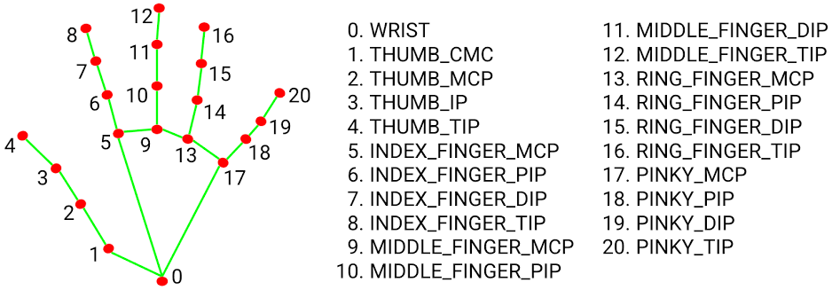
HAND LANDMARKS
6

Slide 12
Key Skills Learned From Project Management
Python Programming:
Strengthened overall proficiency in Python programming language.
Utilized various Python libraries such as http.server, socketserver, urllib, email, cv2, cvzone, smtplib, datetime, textwrap, threading, webbrowser and mysql.connector.
Web Development:
Developed a basic web server using http.server and socketserver to handle HTTP requests.
Created dynamic web interfaces to interact with the Python script (index.html).
Integrated URL parsing (urllib.parse) to manage query parameters.
Database Management (MySQL):
Connected to a MySQL database using mysql.connector.
Executed SQL queries to fetch quiz questions and handle database errors (mysql.connector.Error).
Managed database configurations (db_config) for establishing connections.
Computer Vision (OpenCV):
Implemented webcam video capture (cv.VideoCapture) for real-time image processing.
Utilized hand detection and tracking (HandDetector from cvzone) for gesture-based interactions.
Email Automation (SMTP):
Integrated email sending capabilities using smtplib to notify users of quiz scores.
Handled email composition (MIMEText, MIMEMultipart) and authentication with SMTP server.
Multithreading:
Employed threading to run the web server in a separate thread (threading.Thread).
Managed concurrent execution of multiple components (web server, quiz script) for responsiveness.
Error Handling and Debugging:
Implemented robust error handling (try-except) to manage exceptions during database operations, email sending, and other critical tasks.

Slide 13


TOOLS
PYCHARM :
PyCharm is a popular integrated development environment (IDE) for Python programming. It offers a range of features like code completion, syntax highlighting, and debugging tools. PyCharm supports various frameworks and libraries, making it ideal for developing Python applications efficiently. Its user-friendly interface enhances productivity.
MYSQL WORKBENCH :
MySQL Workbench is a visual database design tool that integrates SQL development, administration, design, and maintenance into a single integrated development environment (IDE). It provides tools for database modeling, SQL development, data synchronization, database administration, and more, making it a comprehensive solution for working with MySQL databases.

Slide 14
TECHNOLOGIES
PYTHON :
Python is a versatile high-level programming language known for its simplicity and readability. It's used for web development, data analysis, artificial intelligence, and more.
MYSQL :
MySQL is a popular open-source relational database management system. It is used for managing and querying databases, supporting SQL for database interactions and data manipulation.
HTML :
HTML (HyperText Markup Language) is the standard markup language used to create and structure web pages. It consists of elements represented by tags that define the content and layout of a webpage.
CSS :
CSS (Cascading Style Sheets) is a language used to style the appearance of web pages. It controls the layout, colors, fonts, and other visual aspects of HTML elements to enhance the presentation of content.
JAVASCRIPT :
JavaScript is a versatile programming language used primarily for web development. It allows for dynamic behavior on websites, including interactive features and manipulating content in the browser.

Slide 15
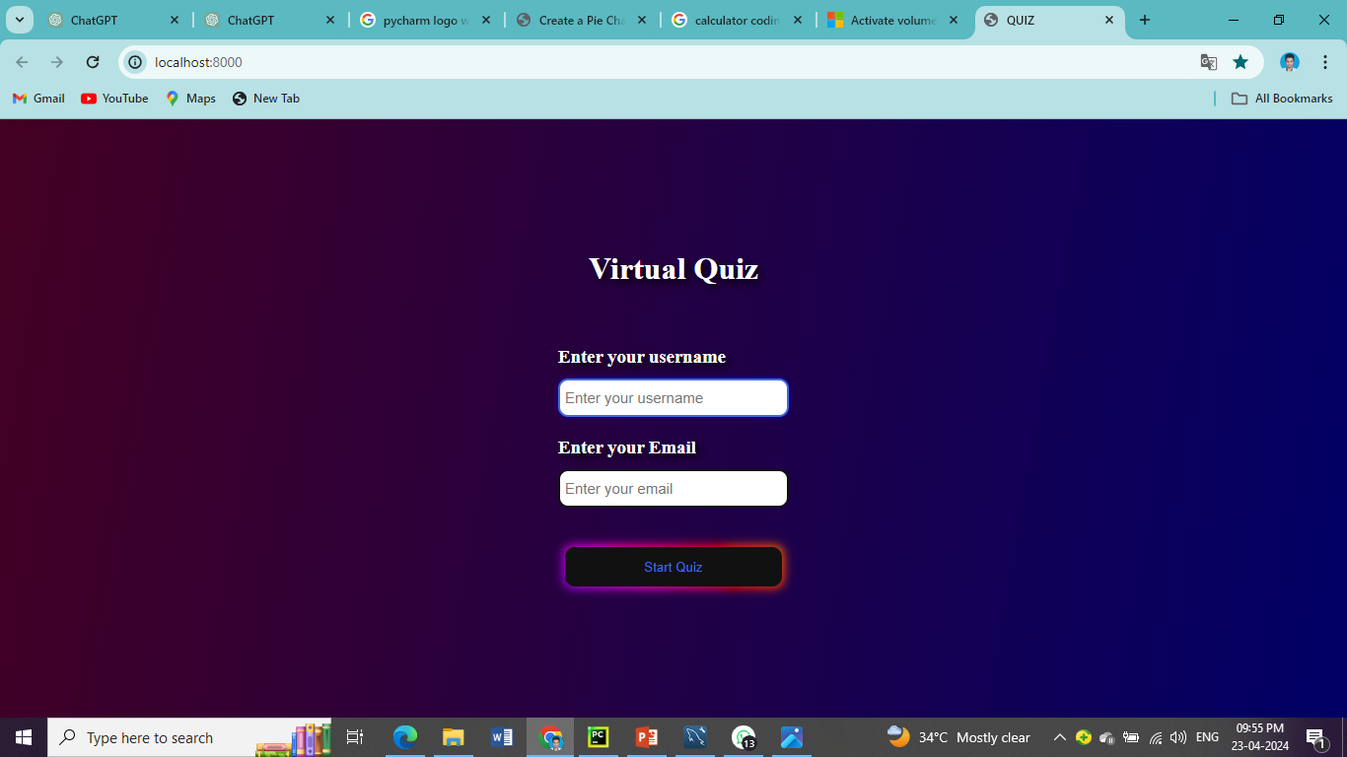
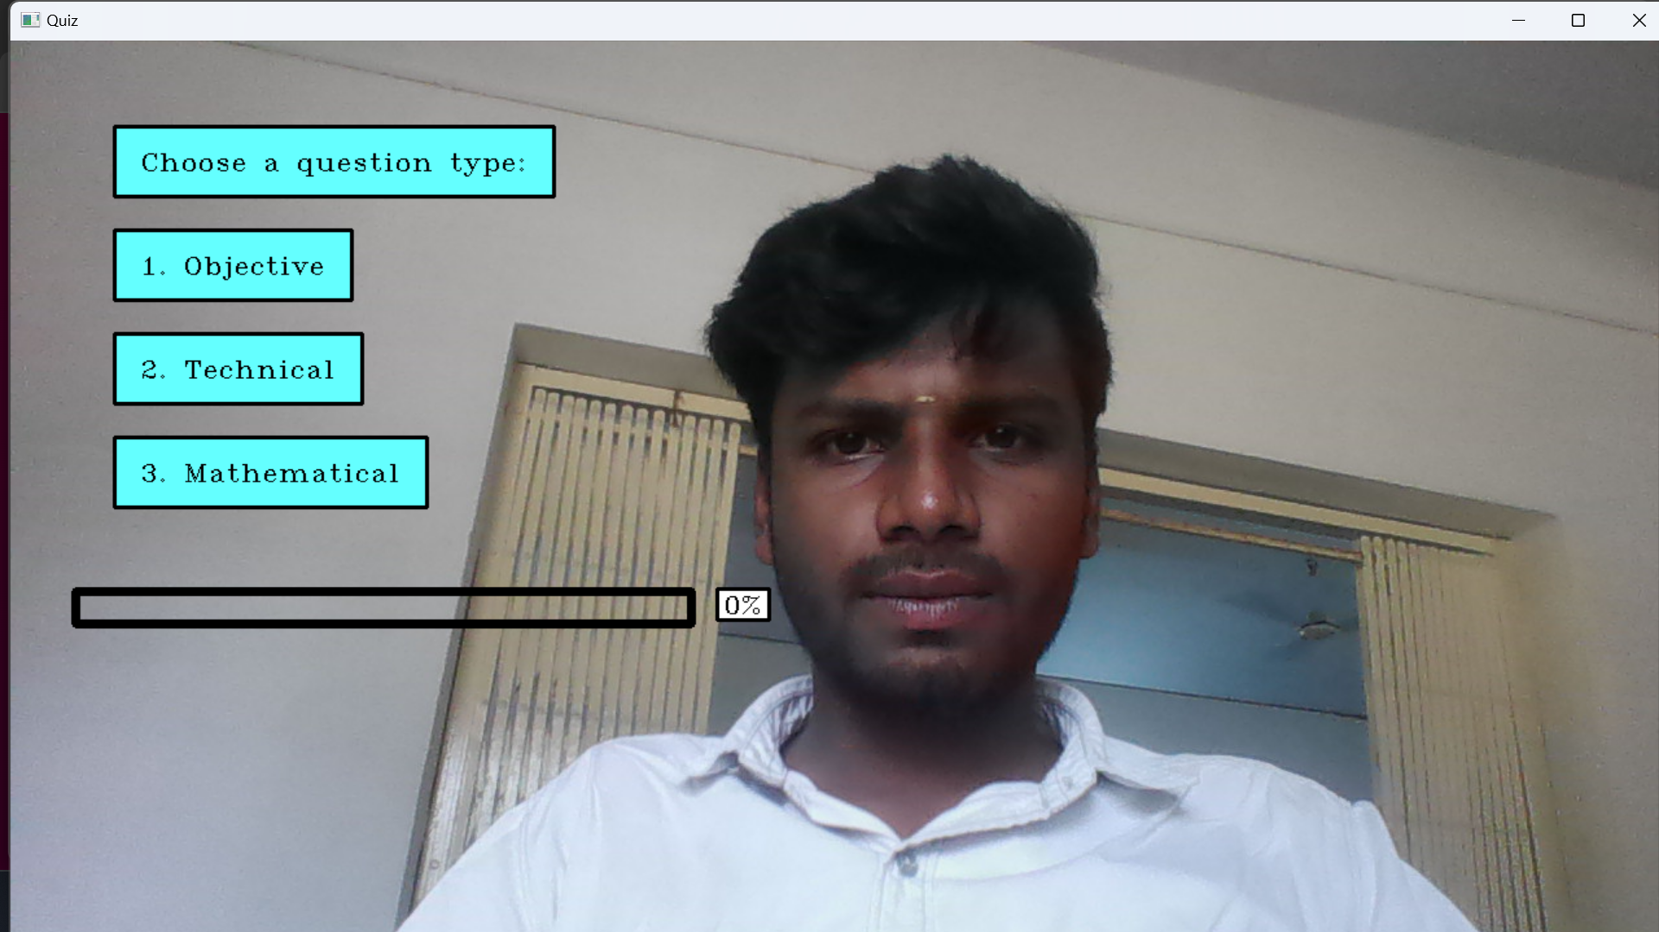
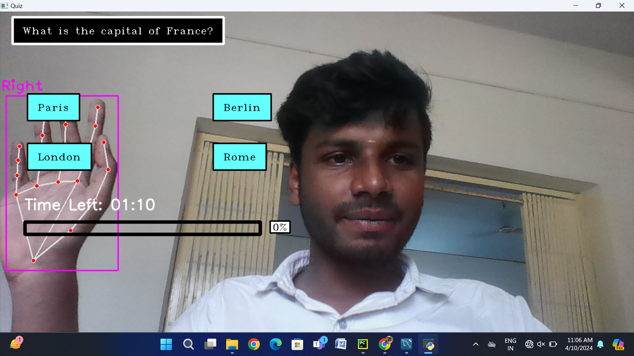
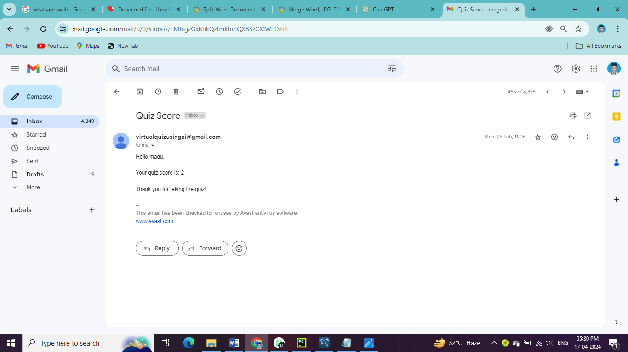
PROJECT SHOWCASE AND CODE

Slide 16
SOURCE CODE
CREATE DATABASE quiz;
USE quiz;
CREATE TABLE quiz ( id INT AUTO_INCREMENT PRIMARY KEY, question TEXT NOT NULL, choice1 TEXT NOT NULL, choice2 TEXT NOT NULL, choice3 TEXT NOT NULL, choice4 TEXT NOT NULL, answer TEXT NOT NULL, type ENUM('objective', 'technical', 'mathematical') NOT NULL);
INSERT INTO quiz (question, choice1, choice2, choice3, choice4, answer, type)VALUES
('What is the capital of India?', 'Mumbai', 'New Delhi', 'Kolkata', 'Chennai', 'New Delhi', 'objective'), ('What is the chemical symbol for water?', 'H2O', 'CO2', 'NaCl', 'O2', 'H2O', 'objective'), ('What protocol is used to retrieve email from a remote server?', 'HTTP', 'SMTP', ‘ POP3', 'FTP', 'POP3', 'technical'), ('Which programming language is used for developing Android apps?', 'Java', 'Python', 'C++', 'Swift', 'Java', 'technical'), ('Which protocol is used for secure communication over the internet?', 'HTTPS', 'HTTP', 'FTP', 'SMTP', 'HTTPS', 'technical'), ('What is the value of 2 + 2?', '3', '4', '5', '6', '4', 'mathematical'), ('Simplify: 3 * (4 + 2) - 8', '14', '16', '18', '20', '14', 'mathematical'), ('What is the square root of 144?', '10', '12', '14', '16', '12', 'mathematical'), ('Find the value of x: 2x + 5 = 15', '5', '6', '7', '8', '5', 'mathematical'), ('What is the area of a rectangle with length 6 and width 4?', '20', '24', '28', '30', '24', 'mathematical');

Slide 17
CONCLUSION
The Python script integrates database connectivity, webcam-based quiz interaction with hand tracking, and email functionality seamlessly. The flowchart illustrates a structured approach to managing these components. This project exemplifies a sophisticated blend of technologies for interactive applications, showcasing the versatility of Python in real-world scenarios.

Slide 18
THANK YOU

